Slide 1
Introduction to Systems Biology
Bio311 – Spring 2017
Lecture 1
Instructors: Amy Schmid, Paul Magwene
TA: Yuantong Ding

Slide 2
Overview
Introduce instructors and TA
Introduce yourself
Go over syllabus.
What is systems biology?
Research vignettes on applications of systems biology.

Slide 3
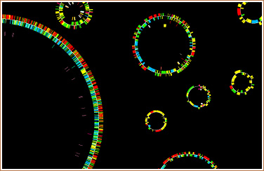
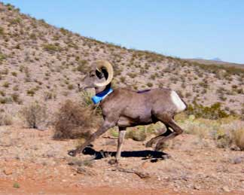
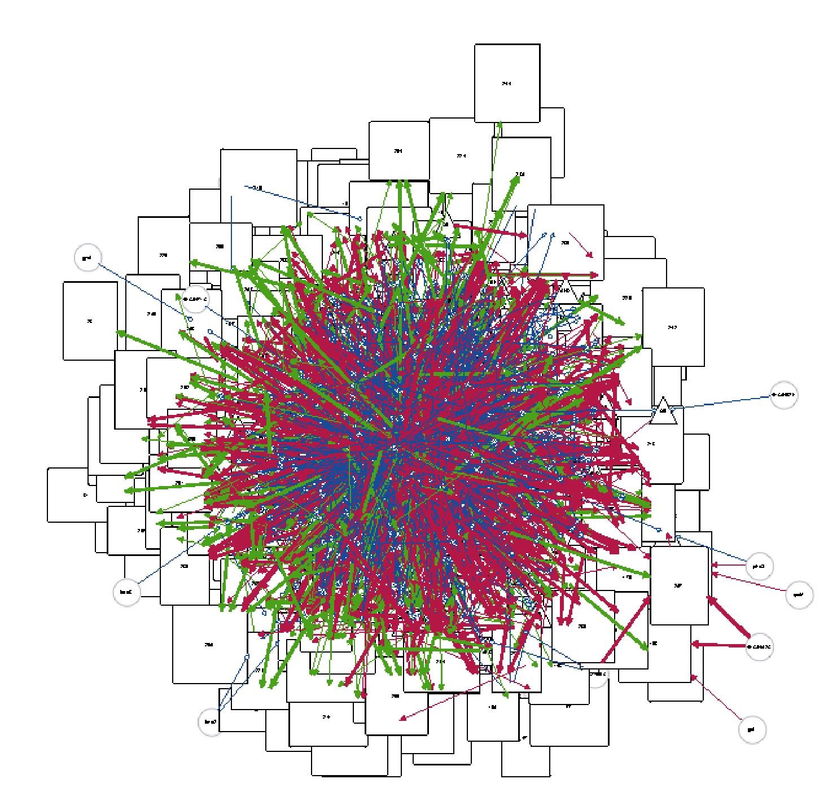
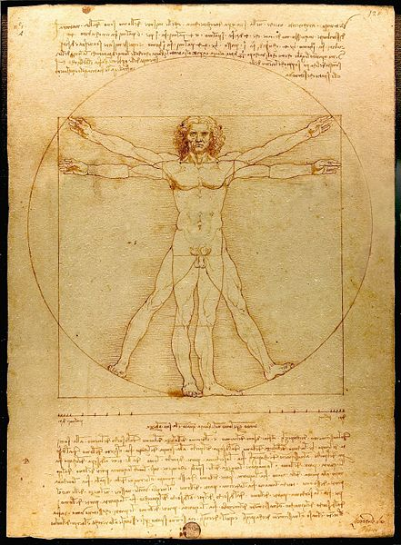
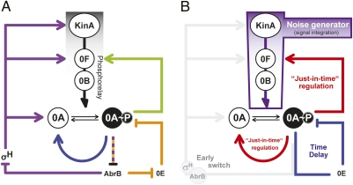
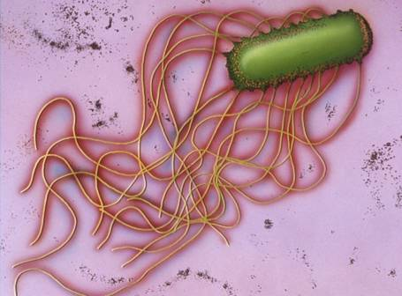
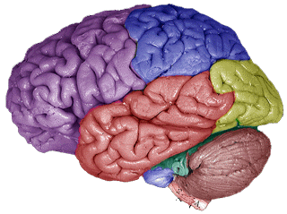
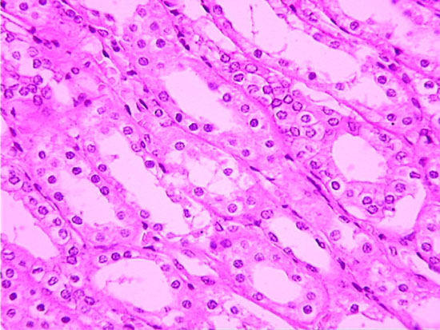
Definition of a “system” at many levels of complexity
Notes:
Systems biology aims to understand biological networks at many levels of complexity
At higher levels, have confounding factors, e.g. splicing, multiple posttranslational modifications.
Use microbes as models to understand emergent properties of biological systems.

Slide 4
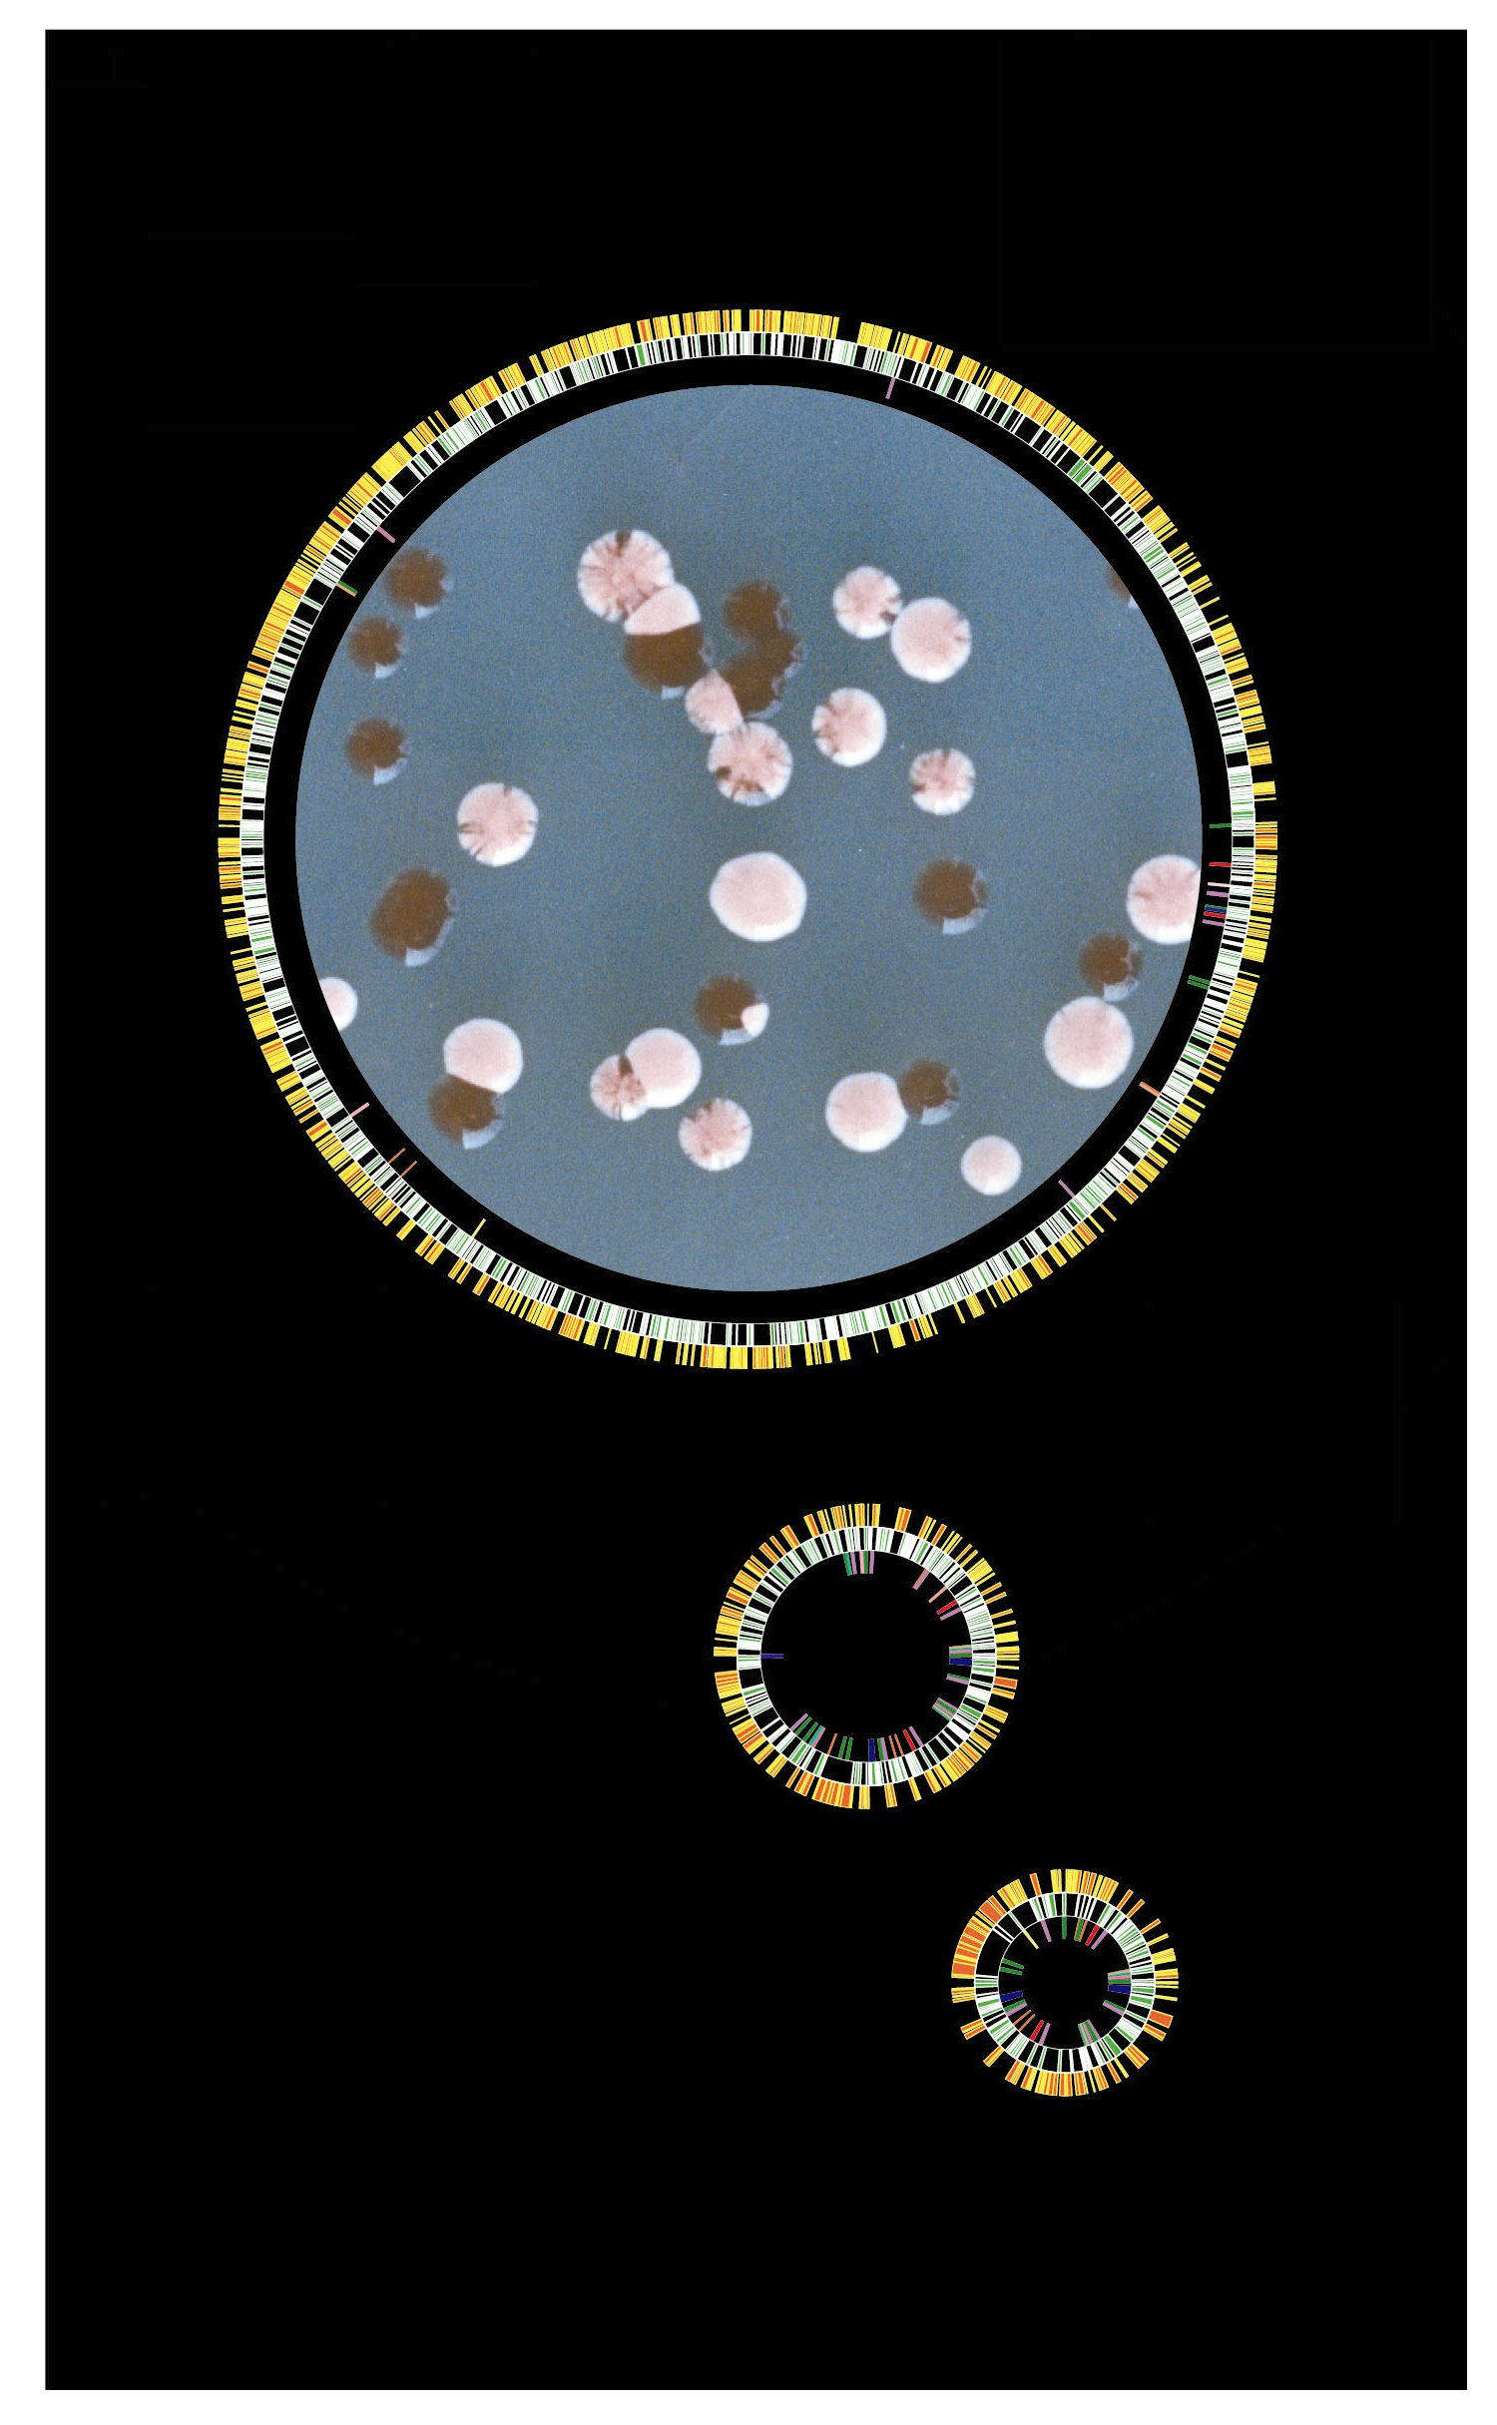
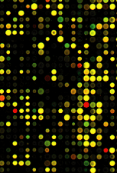
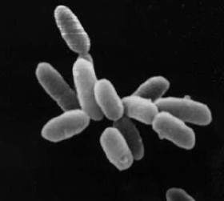
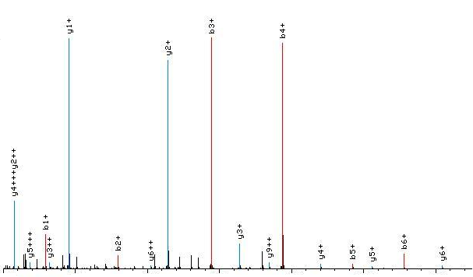
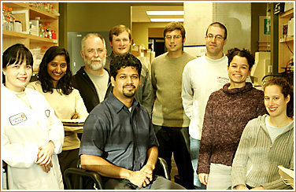
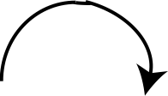
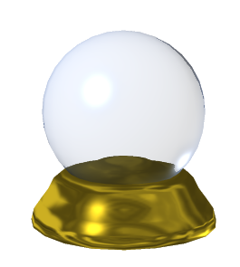
What is systems biology?
Environment
model
PREDICT
Notes:
GLOBAL experiments
Accurate models
PREDICTIVE
ITERATIVE
Top-down and bottom-up approaches possible: I use both.

Slide 5
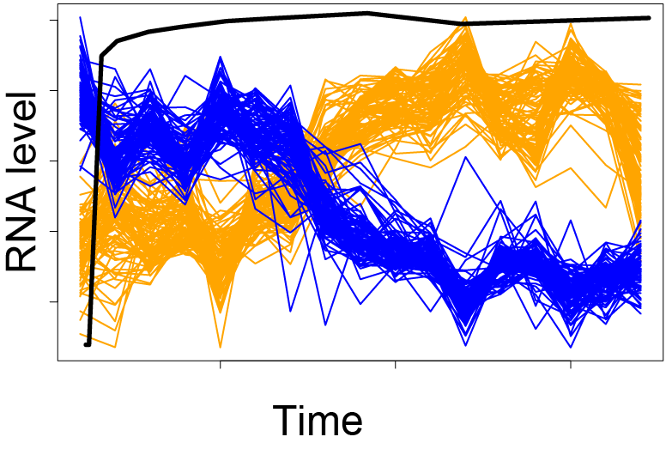
Properties of systems biology
Holistic: Measure levels of all system parts (macromolecules) and interactions between parts (networks)
Simultaneously
Over time
In response to perturbation
Multidisciplinary
Iterative
Test
Predict
Model

Slide 6
Networks on NOVA
http://www.pbs.org/wgbh/nova/physics/pattern-nature-network.html
See also this article on the “diseasome” network for further reading:
http://www.pbs.org/wgbh/nova/next/body/network-medicine/

Slide 7

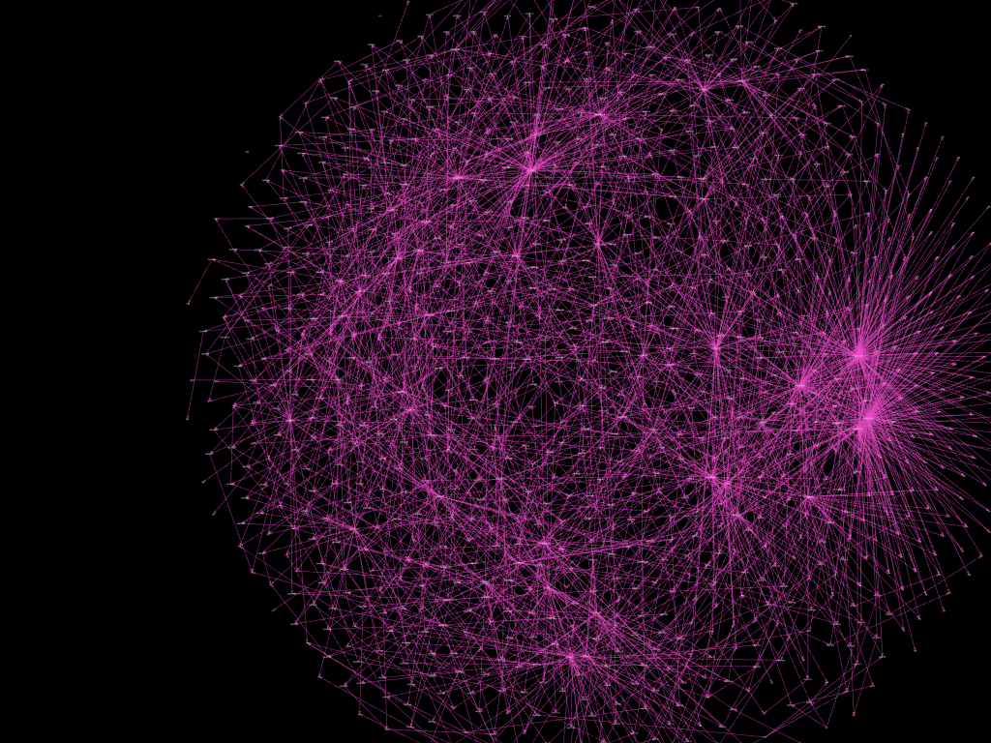
Example: Gene Regulatory Networks

Slide 8

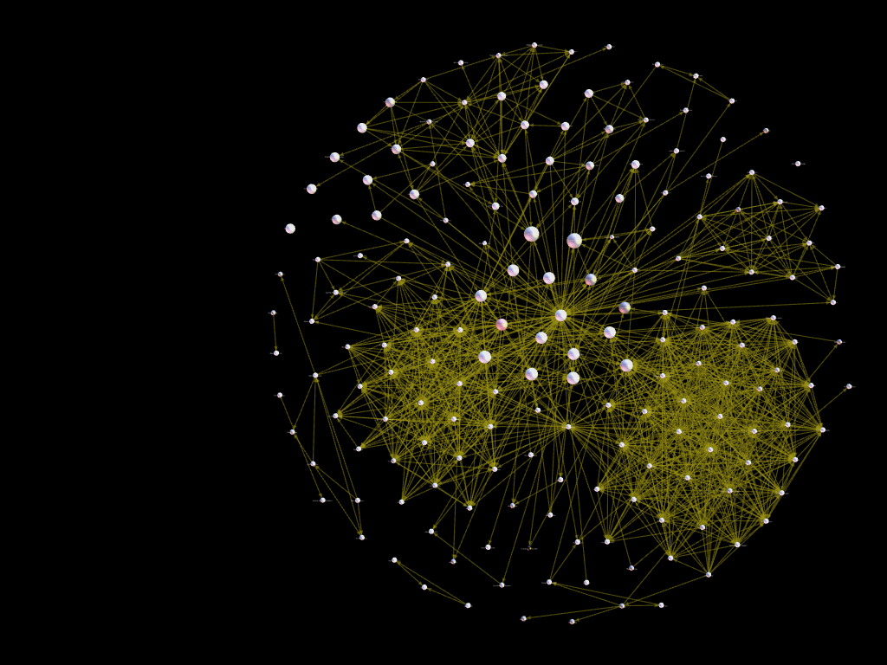
Analogy: Friendship Networks

Slide 9
Emergent properties in large-scale networks
Robustness
Redundancy
Modularity
“Hub-and-spoke” -maximizing efficiency of information flow
Notes:
Many of these deal with, or are revealed by, the study of system dynamics.

Slide 10
Emergent properties in small-scale networks
Hysteresis
Noise filtering
Buffering
Feedback
Criticality
Pattern formation
Notes:
Many of these deal with, or are revealed by, the study of system dynamics.

